Slide 1
PCEP Association GROUP
& the “associated” drafts!
Dhruv Dhody, Huawei

Slide 2
The Association Landscape…
draft-ietf-pce-association-group
draft-ietf-pce-association-diversity
draft-ietf-pce-association-policy
draft-ietf-pce-stateful-path-protection
draft-ietf-pce-association-bidir
draft-leedhody-pce-vn-association
draft-li-pce-sr-bidir-path
draft-zhang-pce-resource-sharing
draft-tanaka-pce-stateful-pce-mbb
draft-barth-pce-segment-routing-policy-cp
WG I-Ds
On agenda (separately)
Individual I-Ds

Slide 3
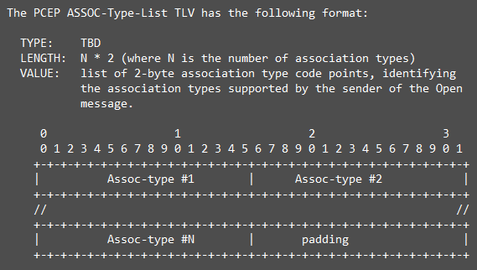
draft-ietf-pce-association-group-06
Status: WG LC done
Last update: One pending comment from Cyril to add “capability advertisement/discovery” for the associations is handled.
Discovery of Supported Association Types
A new PCEP ASSOC-Type-List (Association Types list) TLV is defined to be carried in OPEN.
The use of ASSOC-Type-List TLV is OPTIONAL.
Thus the absence of the ASSOC-Type-List TLV in an OPEN object MUST be interpreted as an absence of information on the list of supported association types (rather than the association-type is not supported).
Association type can be marked as ‘mandatory’
A missing Assoc-type in the ASSOC-Type-List TLV (or missing ASSOC-Type-List TLV) is to be interpreted as the association type is not supported by the PCEP speaker.
Ready for next step!

Slide 4
Now, any I-D that defines a new association type should…
…specify if the association type advertisement is mandatory
…state if the association type is dynamic, operator-configured or both!
Operator-configured Association Range needs to be set for ‘both’!
or not!

Slide 5
Update to the WG I-Ds
draft-ietf-pce-association-diversity-04
draft-ietf-pce-association-policy-03
Capability advertisement (mandatory)
Capability advertisement (mandatory)
Dynamic and Operator-Configured
Operator-configured Association Range must be set
Other editorial changes…
Operator-configured

Slide 6
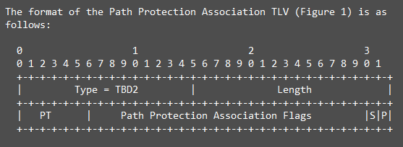
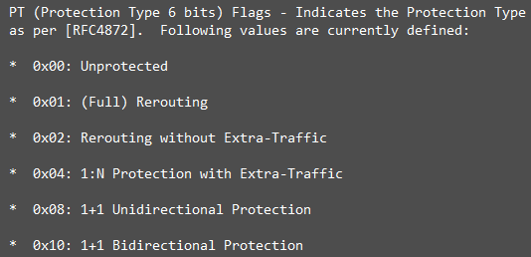
Update to the WG I-Ds
draft-ietf-pce-association-bidir-01
draft-ietf-pce-stateful-path-protection-02
Capability advertisement (optional)
Update done by Rakesh based on the comments received during WG adoption
Figures and description added for single/double-sided initiation
Error handling!
PT field (protection type) – as per RFC 4872
Dynamic

Slide 7
Others
draft-zhang-pce-resource-sharing-06
draft-tanaka-pce-stateful-pce-mbb-06
draft-barth-pce-segment-routing-policy-cp-00
No update
Capability advertisement (mandatory)
Dynamic
Editorial Changes
Error Handling
New I-D for associating various candidate SR path belonging to a SR-TE policy
SR Candidate Path Association Group
with a TLV to identify SR-TE policy (Color, Destination end-point, Preference)

Slide 8
Next Step
This is quite an useful feature..
Evident from the list of association types being specified…
Let get the shepherd reviews done for association group and ship to the IESG
We could then decide the order for other association types!

Slide 9
Thanks!

